Slide 1


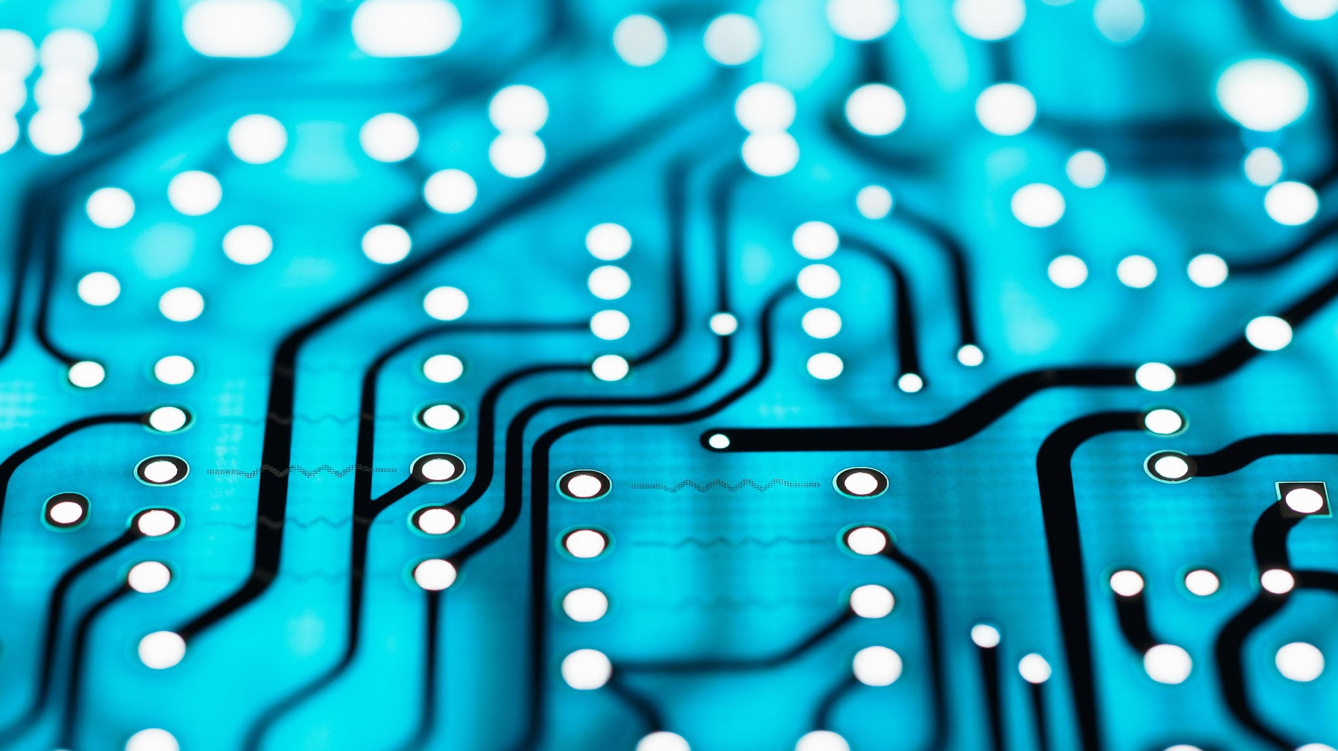
HELMET DETECTION IMAGE CLASSIFICATION WITH TENSORFLOW
ABHISHEK SINGH YADAV(04)
BELO ABHIGYAN (16)
RAHUL KUMAR MANJHI (44)

Slide 2

INTRODUCTION
In today's world, safety is of paramount importance, especially in high-risk industries such as construction and manufacturing. One crucial aspect of safety is helmet detection, which can help identify individuals not wearing proper head protection. In this presentation, we will explore the application of Convolutional Neural Networks (CNNs) for helmet detection.

Slide 3
LIBRARIES AND TOOLS
numpy | A library for numerical operations in Python.
matplotlib | Used for creating visualizations, particularly plots.
os | Provides a way to interact with the operating system, such as reading or writing files.
cv2 | A computer vision library for image and video processing.
cv2_imshow | part of the google.colab.patches module and is designed to display images in Colab notebooks.
keras.models.Sequential | Part of the Keras deep learning library, used to create a linear stack of layers in a neural network.
keras.layers | Various types of layers that can be added to the neural network (e.g., Dense, Dropout, Conv2D).
PIL | Python Imaging Library (PIL), now known as the Pillow library
Augmentor | helps in improving the model's generalization by exposing it to a wider range of variations and ensuring that it can perform well on different inputs.

Slide 4
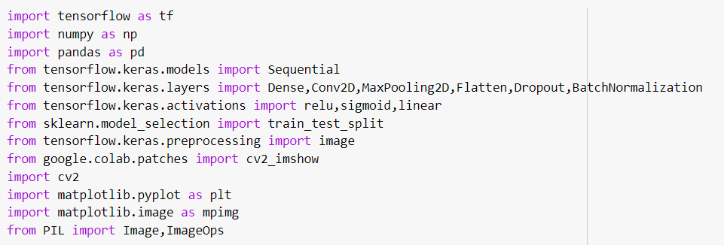
IMPORTING NECESSARY LIBRARIES

Slide 5
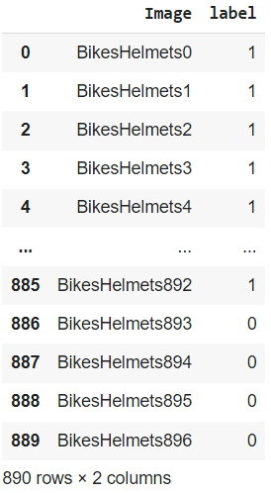
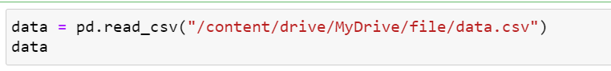
DATA LOADING
Before diving into the helmet detection process, it is essential to load the dataset. We will utilize the Pandas library to load the data from the 'data.csv' file into a DataFrame. This will provide us with the necessary information to proceed with the classification task.

Slide 6
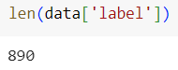
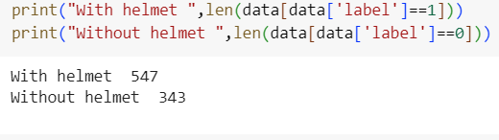
DATA EXPLORATION
Let's explore the dataset we have for helmet detection. We will start by checking the length of the 'label' column, which will give us an idea of the dataset size. (The Dataset contains a total of 890 labeled images)

Slide 7
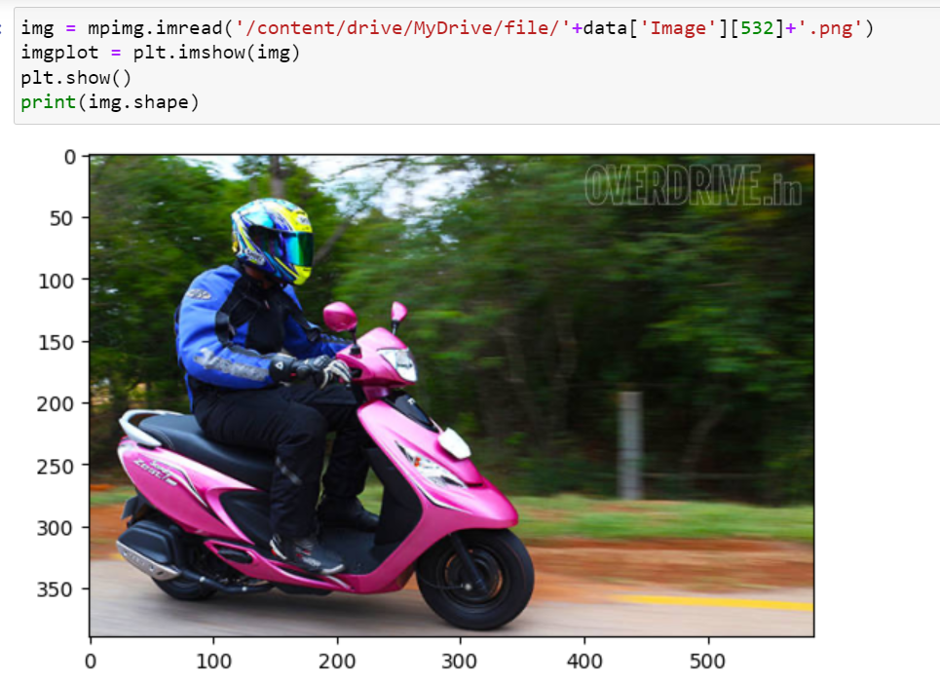
DATA EXPLORATION
Additionally, we will display an example image from the dataset using the Matplotlib library.

Slide 8
DATA AUGMENTATION
As we are lacking to gain a decent accuracy of our model due to not having a enough data, for that we used the data augmentation concept.
Data augmentation is the process of increasing the amount and diversity of data. We do not collect new data, rather we transform the already present data.

Slide 9
DATA AUGMENTATION
Need for data augmentation
Data augmentation is an integral process in deep learning, as in deep learning we need large amounts of data and in some cases it is not feasible to collect thousands or millions of images, so data augmentation comes to the rescue. It helps us to increase the size of the dataset and introduce variability in the dataset. The most commonly used operations are-
Rotation
Shearing
Zooming
Cropping
Flipping
Changing the brightness level

Slide 10
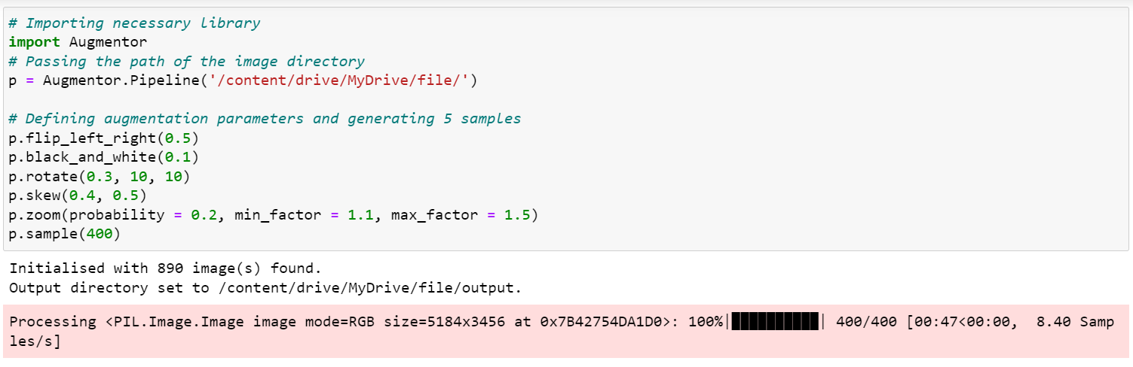
DATA AUGMENTATION
This code uses the Augmentor library to create an augmentation pipeline, defines various augmentation operations with specific probabilities, and generates a specified number of augmented samples from the input images. This is useful for diversifying a training dataset and improving the robustness of a machine learning model.

Slide 11
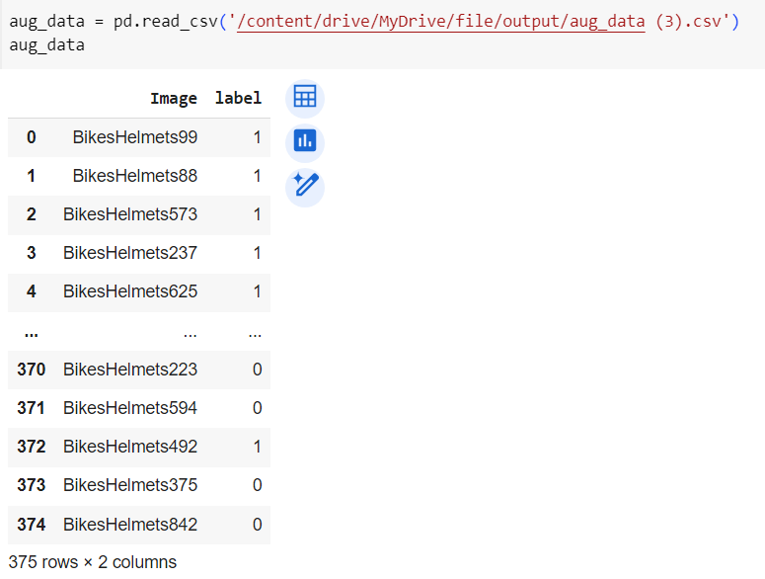
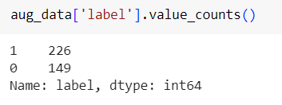
AUGMENTED DATASET

Slide 12
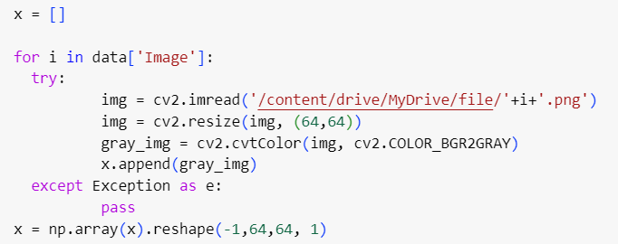
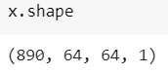
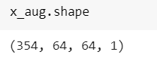
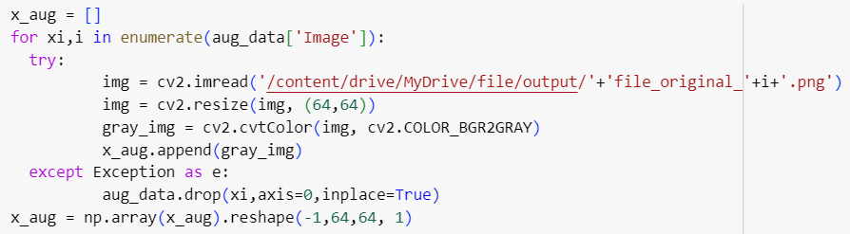
DATA PREPROCESSING

Slide 13
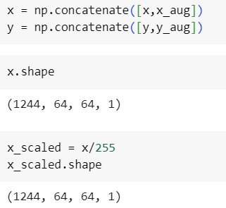
MERGING ORIGINAL DATA WITH AUGMENTED DATA AND DATA SCALING
To enhance the training process, it is important to scale the pixel values of our images. By normalizing the pixel values to a range of [0, 1], we can improve the convergence of our CNN model.

Slide 14
TRAIN-TEST SPLIT
The purpose of splitting the dataset into training and testing sets is to train a machine learning model on one subset (training set) and evaluate its performance on another independent subset (testing set). This helps assess how well the model generalizes to unseen data. The train_test_split function automates the process of creating these splits.
WE HAVE VERY LESS DATA AVAILABILITY SO WE BREAK IT INTO 90:10

Slide 15
MODEL ARCHITECTURE
Now that we have preprocessed our data, let's delve into the architecture of our CNN model. We will utilize a sequential model, incorporating layers such as Conv2D, MaxPooling2D, Flatten, Dense, and Dropout. This architecture is designed to effectively extract features from the input images and make accurate predictions.

Slide 16
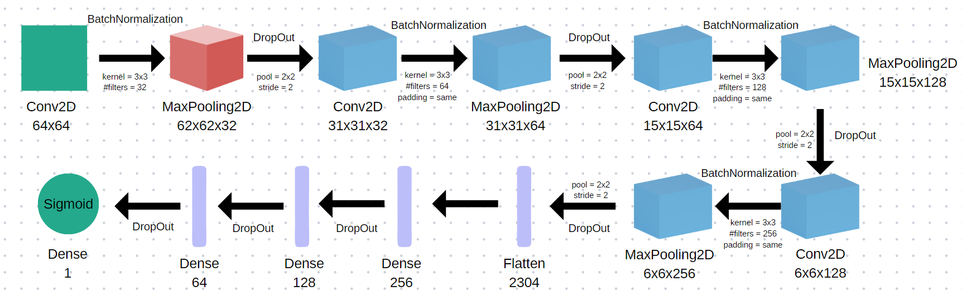
MODEL ARCHITECTURE

Slide 17
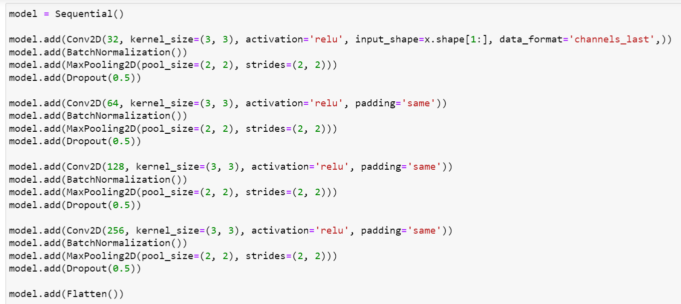
MODEL ARCHITECTURE
CONTINUED….

Slide 18
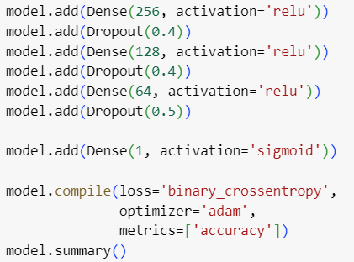
MODEL ARCHITECTURE

Slide 19
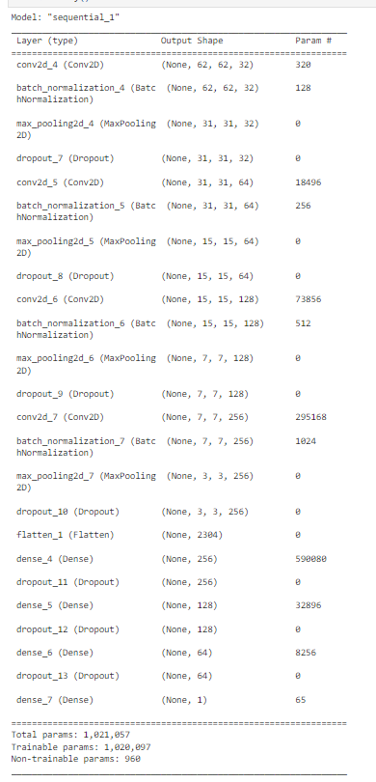
Total params: 1,021,057
Trainable params: 1,020,097
Non-trainable params: 960

Slide 20
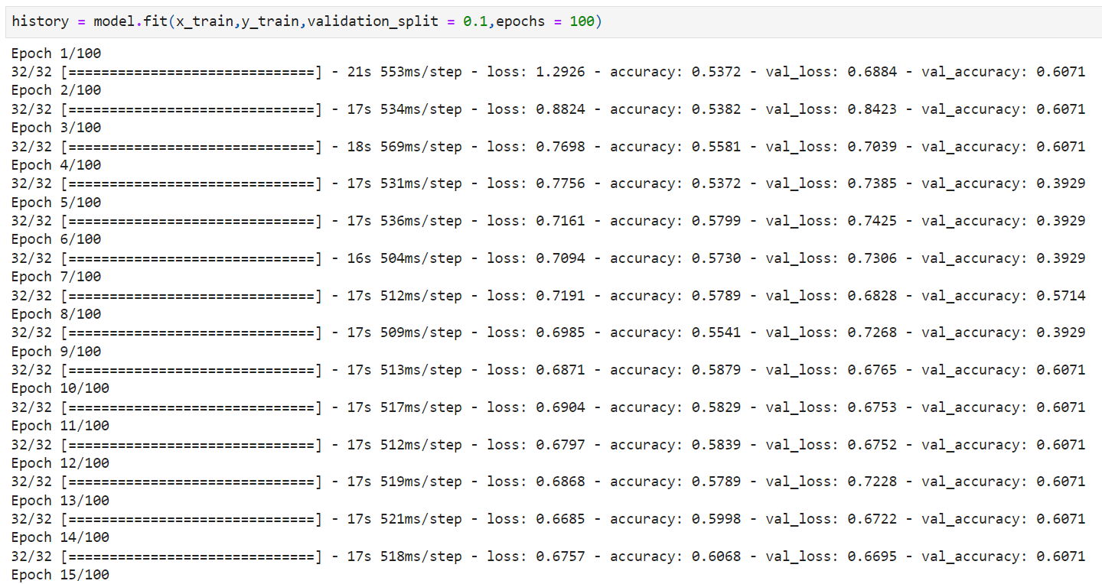
MODEL TRAINING
Now it's time to train our CNN model on the preprocessed dataset. We will train the model for 100 epochs, iterating over the training set while validating the results on a 10% validation split. This iterative process will allow our model to learn and make accurate predictions on helmet detection

Slide 21
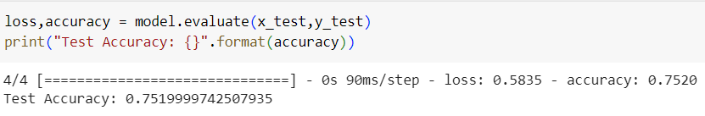
MODEL EVALUATION
After training the model, it's crucial to evaluate its performance. We will assess the accuracy of the model by testing it on the unseen testing set. This evaluation step will give us an indication of how well our helmet detection model performs on real-world data.

Slide 22
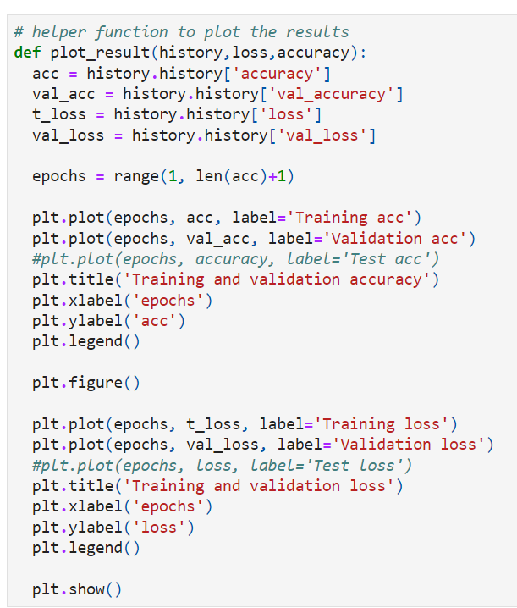
TEST/TRAIN HISTORY PLOT
Creating a helper function for plotting the results

Slide 23
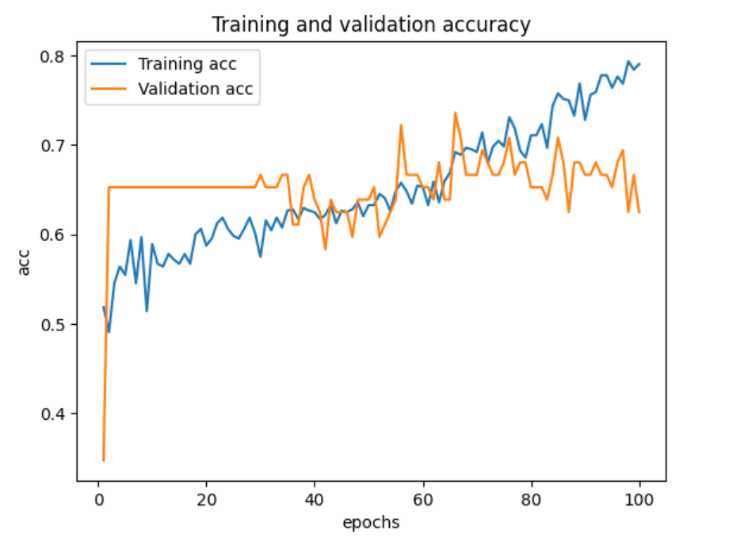
TRAINING AND VALIDATION ACCURACY
Training Accuracy : Plot displaying the training accuracy over the course of the training epochs
Validation Accuracy : Plot showcasing the validation accuracy over the course of the training epochs.

Slide 24
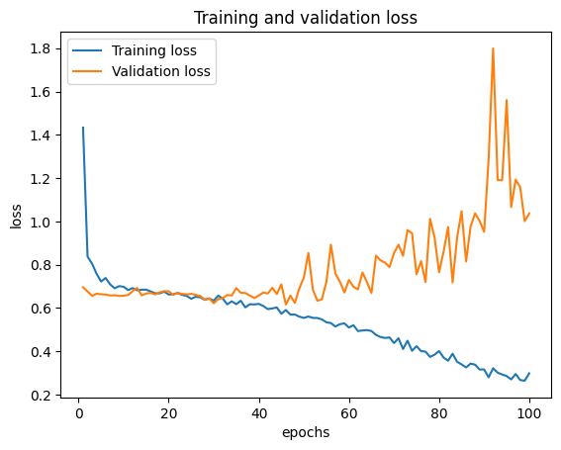
TRAINING AND VALIDATION LOSS
Training Loss : Plot showing the training loss over the course of the training epochs.
Validation Loss : Plot illustrating the validation loss over the course of the training epochs.

Slide 25
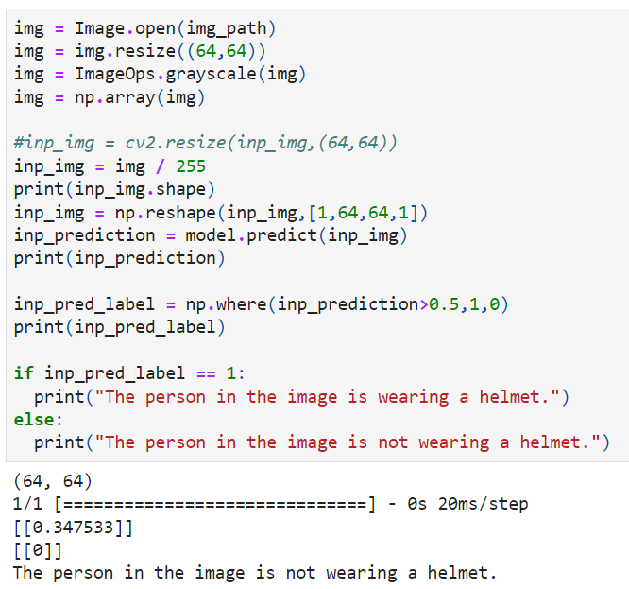
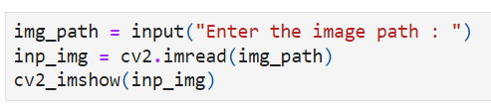
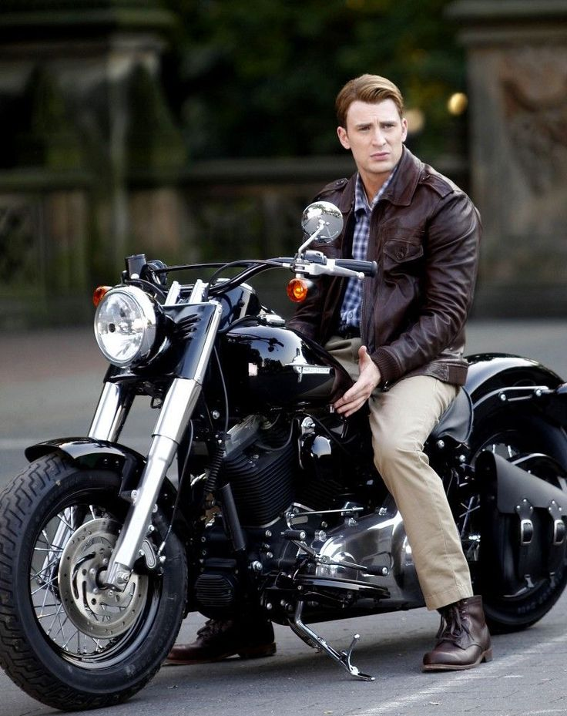
USER INPUT FOR PREDICTION 1

Slide 26
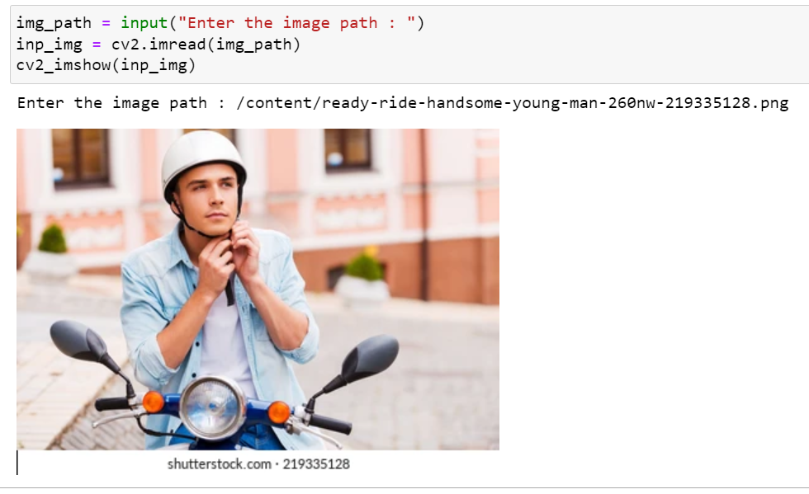
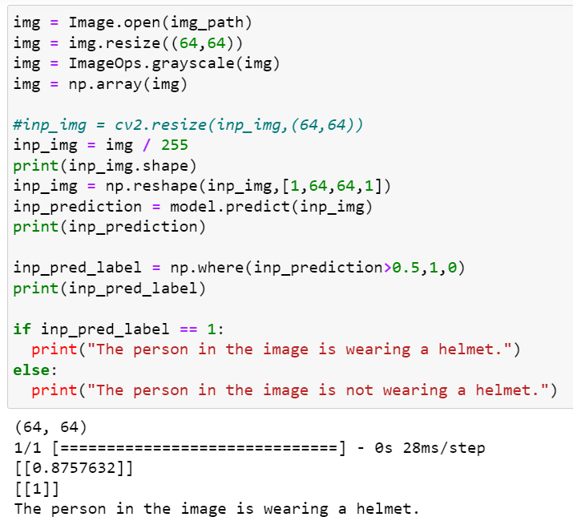
USER INPUT FOR PREDICTION 2

Slide 27
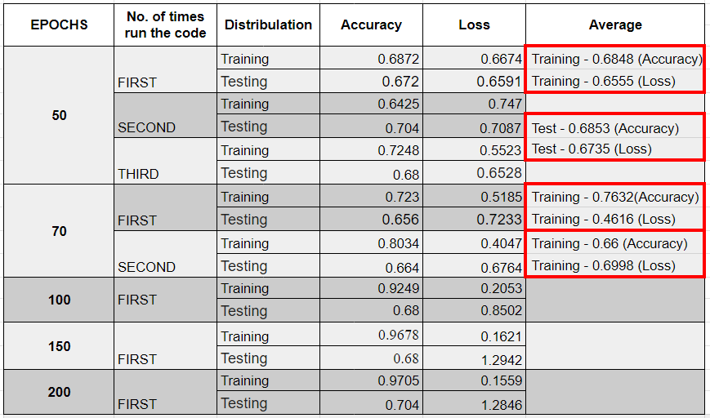
RESULT

Slide 28
CONCLUSION
In conclusion, our exploration into the helmet detection task using Convolutional Neural Networks (CNN) has yielded promising results, with an achieved accuracy of 68.53%. This accomplishment underscores the effectiveness of employing deep learning techniques in addressing safety concerns, particularly in scenarios where helmet detection plays a crucial role.
The successful implementation of CNN for helmet detection opens up avenues for enhanced safety measures in various contexts, such as construction sites, industrial facilities, and outdoor recreational activities. The utilization of advanced technologies like CNN not only improves accuracy but also lays the foundation for the development of more sophisticated and robust safety systems.

Slide 29
FUTURE SCOPE
However, as with any technological advancement, there is always room for improvement and expansion. Looking ahead, the future scope of this project includes:
Performance Optimization: Investigate and implement strategies to further enhance the accuracy of helmet detection, such as fine-tuning the model architecture, exploring alternative algorithms, or incorporating additional data augmentation techniques.
Real-time Implementation: Work towards real-time implementation of the helmet detection system, ensuring its practicality and effectiveness in dynamic environments where prompt safety responses are crucial.
User Interface Enhancement: Develop an intuitive and user-friendly interface for the end-users, allowing easy customization, monitoring, and management of the helmet detection system.
Dataset Expansion: Continuously enrich the dataset with diverse images and scenarios to improve the model's adaptability to a wider range of environments and conditions.

Slide 30
THANK YOU

